Slide 1

Artificial Intelligence For NLP Lesson-04
人工智能与自然语言处理课程组
2019.April. 20

Slide 2
Some References
SICP, Structure and Interpretation of Computer Programming. 《计算机程序设计的解释和构造》
Introduction to Algorithms 《算法导论》
Artificial Intelligence A Modern Approach (3rd Edition) 《人工智能：一种现代方法》
Code Complete 2 《代码大全》
Programming Pearls 《编程珠玑》
Deep Learning, 《深度学习》
《黑客与画家》
《数学之美》， 吴军
Fluent Python
Hands on Tensorflow
Conference: NIPS， ICML， ICLR， ACL， AAAI

Slide 3
AI for NLP PATHROAD
Lesson-10
Word Embedding Advanced
Lesson-14
Recurrent Neural Networks, LSTM, GRU
Lesson-06
Model, Validation, Test
Lesson-01 BSF, Syntax Tree
Lesson-17
Unsolved Problems in AI fields
Lesson-11
Backprogation, Softmax, Crossentropy
Lesson-02 Probability Model
Lesson-07 Logistic Regression, Linear Regression
Lesson-15
Convolutional Neural Networks
Lesson-03, Machine Learning, Heuristic Search
Lesson-07 KNN,SVM,Bayes
Lesson-12
Dense Neural Netwokrs
Lesson-16
Sequence2Sequence, Attention, Transformer, BERT
Lesson-04/05, Basic NLP Methods
Lesson-09 Unsupervised Leanring
Lesson-13
Tensorflow, Keras

Slide 4
What NLP concerns
1. Words
2. Entity
3. Syntax
4. Semantic
5. Dialogue
6. Reading Comprehension
7. Generation
Representation + Policy

Slide 5
Why NLP?
There are so many sub-fields of Artificial Intelligence
Computer Vision
Predication and Data Mining
Optimization
Self Driving
Recommend System
etc

Slide 6
Why NLP?
Information Chaos
Unstructured
Discrete
Unconventional
OOV

Slide 7
Why NLP?
Language is the representation of mind.
The most “classical” field of AI
The most “immature” field of AI
The most “sophistical” field of AI
1. How to flatten the parenthesizes:
((1, 2), (3, 4), (5, 6), (((8, 9), 10), 11))
2. Remove the duplication
[1, 2, 2, 2, 1, 1, 2, 1, 1, 2, 4, 4, 5, 4, 5, 6, 6, 7, 9, 10, 11, 4, 5, 6, 6, 7, 9, 10, 11]

Slide 8
Some utilities for NLP
1. Similarity: Edit Distance, Word Distance
2. Key words
3. Name Entity Recognition
4. Dependency Parsing
5. Topic Model

Slide 9
Dynamic Programming
1. Rob Cutting Problem
2. Edit-Distance Problem
3. Key Characteristics for Dynamic Programming
4. The Travel Salesman Problem

Slide 10
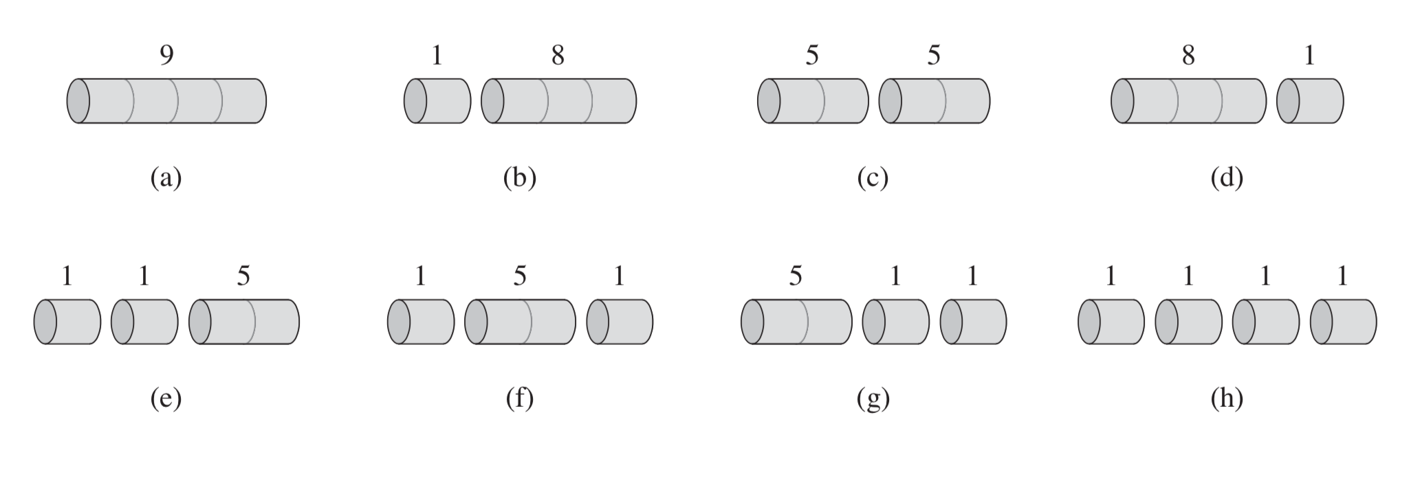
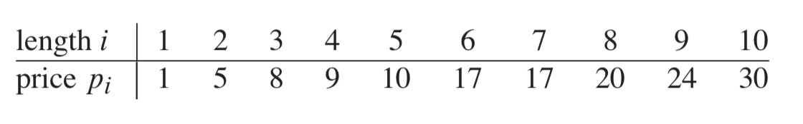
Determine the maximum revenue by cutting

Slide 11
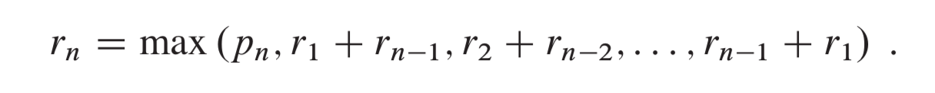
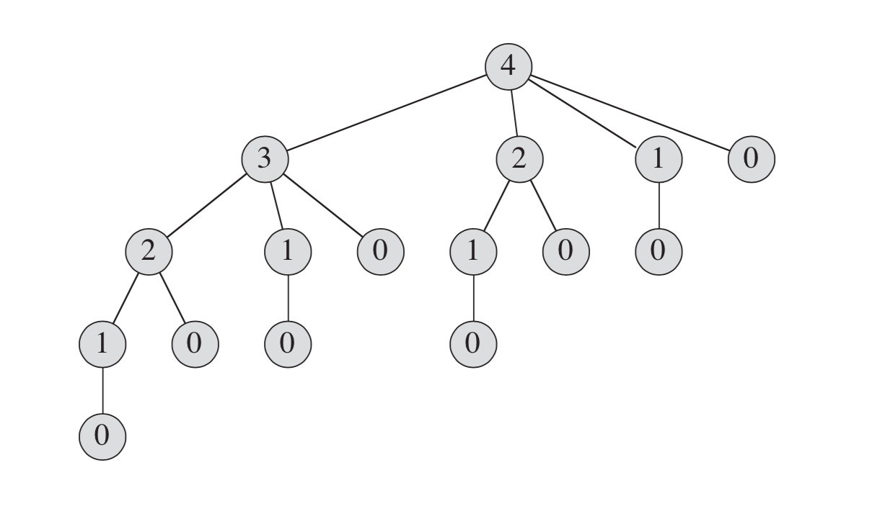

Slide 12
Programming Solution For This

Slide 13

Problem 2: Edit Distance
• Insertion
• Deletion
• Substitution

Slide 14
How similar are two strings?
Spell Correction
The user typed “biejing”
--biejie? (别介)
--beijing? (北京)
--beijin? (被禁)
Evaluating Machine Translation and speech recognition
Spokesman confirms senior government adviser was shot.
Spokesman said the senior adviser was shot dead.

Slide 15
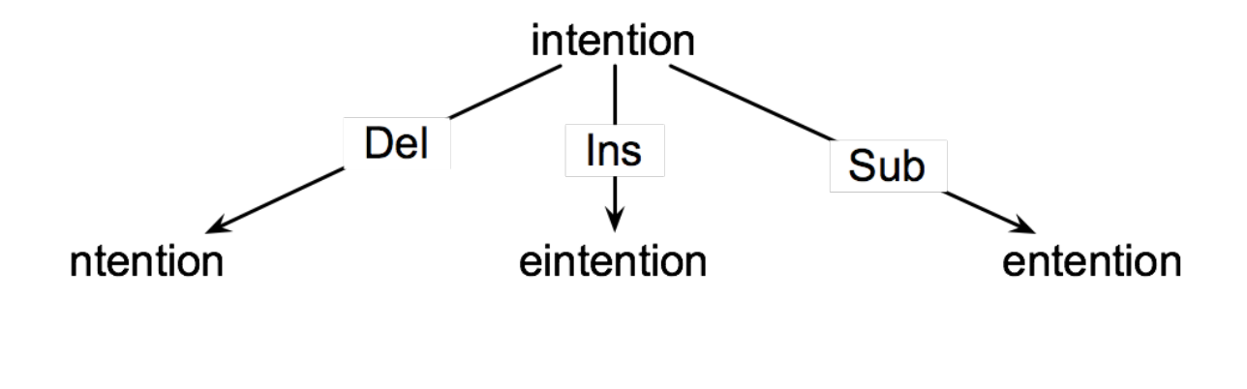
Search Graph is Huge

Slide 16
Defining Min Edit Distance
For two strings
X of length n
Y of length m
We define D(i, j)
the edit distance between X[1…i] and Y[1..j]
The edit distance between X and Y is thus D(n, m)

Slide 17
Defining Min Edit Distance (Levenshtein)
Initialization
D(i, 0) = i
D(0, j) = j
D (i, j) = min
D(i – 1, j) + 1
D(i, j - 1) + 1
D(i – 1, j - 1) + 2 if X(i) != Y(i) else D(i – 1, j - 1)

Slide 18
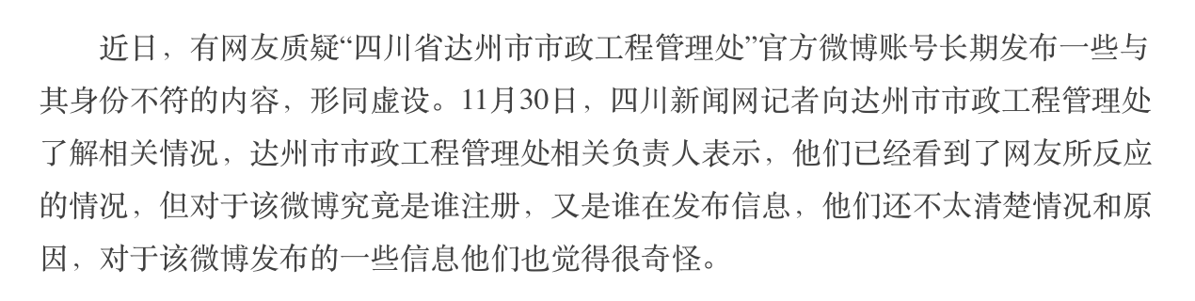
Similarity: Word2Vec
Edit Distance
Looks Like but not means same
Talk: What’s the advantages and disadvantages of Edit Distance?

Slide 19
Word Embedding
1. What is embedding
1
2. Why we need word embedding
2
3. How do we implement word embedding;
3
One-hot; PCA, SVD
4. What is the word embedding
4

Slide 20
Representation
Why do we need to represent words and text?
The only could be computing is number for computers.
How to represent words?
ASCII: a, b, c : 97, 98, ‘abc’: 979899
Unicode:
etc: UTF-8

Slide 21

Why do not represent words as numbers?
‘你今天真好看’: \u12412, \u32121, \u5542,\u189301 => [12412, 32121, 5542, 189301]
Is words numeric or categorical?
How can we represent it as one-hot?

Slide 22
Question
Are words merely categorical?
() A: Yes, there are no mathematical relations between different words;
() B: No, Some words are much ‘closer’ than some others.

Slide 23
If we treat we words as mere categorical
[0, 0, 0, 1]
[0, 1, 0, 0]
[1, 0, 0, 0]
[0, 0, 1, 0]
Cannot keep similarity: (v1 + v2) · v3 == v1 · v3

Slide 24
Question
The problem of representing words as one-hot.
[ ] A. Cannot represent the relation of ‘similar' words and some ‘not similar words’;
[ ] B. The are space consuming;
[ ] C. It’s difficult to get the values;
[ ] D. If we add new words, we need to re-calculate all the words;

Slide 25
Some more dense vectors
1. If we do PCA of this of this one-hot matrix;
What is PCA
How do we get PCA: https://www.wikiwand.com/en/Principal_component_analysis
2. If we do SVD of this one-hot matrix;
What is SVD
How do we get SVD: https://www.wikiwand.com/en/Singular-value_decomposition

Slide 26
Question
Problems of PCA and SVD:
[ ] A. When adding new words, need recalculate all the words;
[ ] B. It’s computing consuming.
[ ] C. This algorithm it’s hard to implement.
[ ] D. Cannot Solving Polyseme(多义词)

Slide 27
What features do our vectors need ?
1. Space Economical
2. Adaptively Update
3. Semantic Similarity
But how?

Slide 28
“You shall know a word by the company it keeps”
“每天早上我都要去门口那家早餐店吃___”
“昨天早上我是在家做的___，味道还不错”
Assuming a density vector <v1, v2, .. vN>
If occurrence position of some words always is same of the position of this vector;
We get the similar vector;

Slide 29
Embedding
What is embedding?
Graph embedding, node embedding, graph embedding, etc
Importance of representation.

Slide 30
How can we get the word vector by this hypothesis?
Assuming a vector v1, depend on some linear project, to a new space v1’, how can we evaluate this v1’ is good or bad?
We test if the co-occurrence feature could keep.
v1 —> v1’ —> v1’M ==> (word1, word2, word3)
v2 —> v1’ —> v2’M ==> (word1, word2, word4)
v1 is similar as v2

Slide 31
The Plotting Show of Word2Vec Principle
The more detail we will talk on lecture 10 or lecture 11

Slide 32
How we use word embedding in python?
Gensim is our friend ☺
Jieba is our friend ☺
Wikipedia is our friend ☺

Slide 33
Keywords and Words-cloud
TF-IDF Keywords
Words Cloud
Based on Graph and Word Embedding
Text-Rank (We will talk in future)
Based on Machine Learning(We will talk in future)
(on line coding presentation)

Slide 34
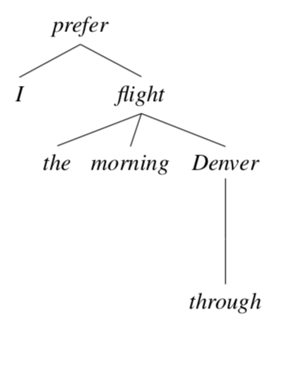
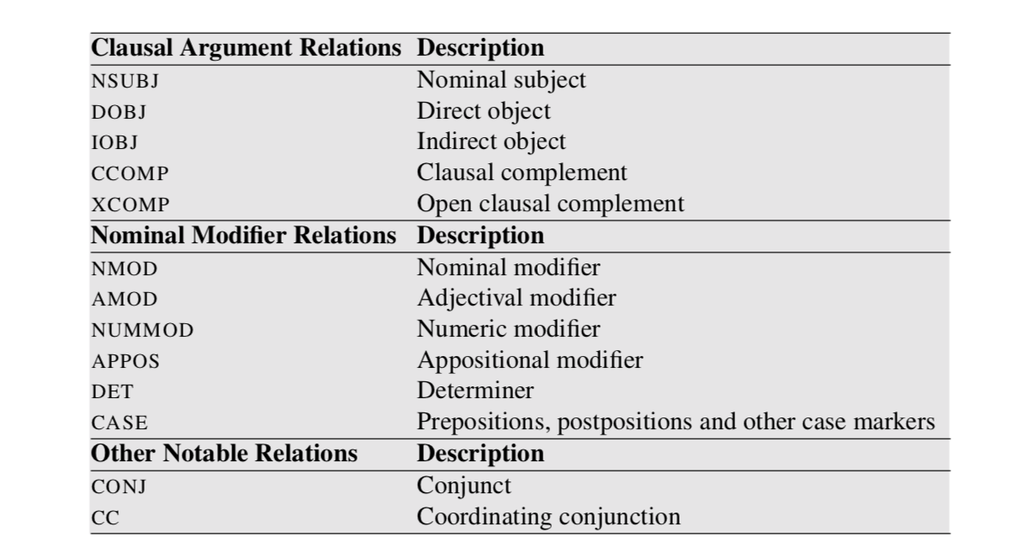
Dependency Parsing

Slide 35
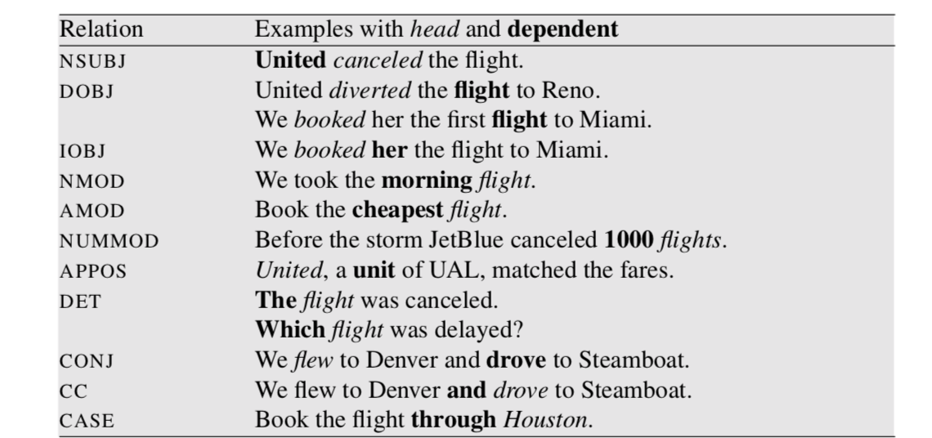
Natural Language Processing: Chapter-14, this book is saved on our github repository

Slide 36
Lecture - 6
NER
Dependency Parsing
Boolean Search

Slide 37
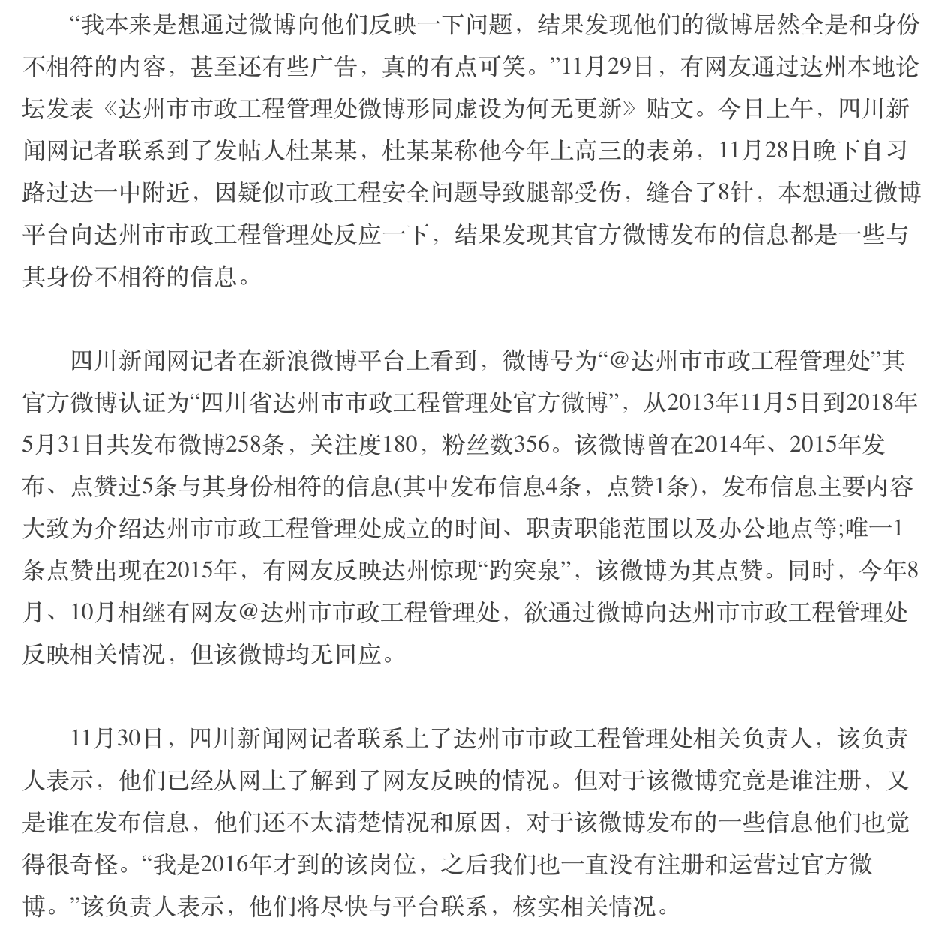
Project - 01
Extracting the Person’s talk from New Corpus.
Dataset: News Corpus
Toolset: Pandas, Matplotlib, Numpy, Jieba, Gensim
Applicatoin:
Trending Analysis
Knowledge Graph
Semantic Analysis
Risk Predication

